Slide 1
7
Sampling Distributions and Point Estimation of Parameters
CHAPTER OUTLINE
7-1 Point Estimation
7-2 Sampling Distributions and the Central Limit Theorem
7-3 General Concepts of Point Estimation
7-3.1 Unbiased Estimators
7-3.2 Variance of a Point Estimator
7-3.3 Standard Error: Reporting a Point Estimate
7-3.4 Mean Square Error of an Estimator
7-4 Methods of Point Estimation
7-4.1 Method of Moments
7-4.2 Method of Maximum Likelihood
7-4.3 Bayesian Estimation of Parameters

Slide 2
Learning Objectives for Chapter 7
After careful study of this chapter, you should be able to do the following:
Explain the general concepts of estimating the parameters of a population or a probability distribution.
Explain the important role of the normal distribution as a sampling distribution.
Understand the central limit theorem.
Explain important properties of point estimators, including bias, variances, and mean square error.
Know how to construct point estimators using the method of moments, and the method of maximum likelihood.
Know how to compute and explain the precision with which a parameter is estimated.
Know how to construct a point estimator using the Bayesian approach.

Slide 3
Point Estimation
A point estimate is a reasonable value of a population parameter.
Data collected, X₁, X₂,…, X_{n} are random variables.
Functions of these random variables, x-bar and s₂, are also random variables called statistics.
Statistics have their unique distributions that are called sampling distributions.

Slide 4
Point Estimator

Slide 5
Some Parameters & Their Statistics
There could be choices for the point estimator of a parameter.
To estimate the mean of a population, we could choose the:
Sample mean.
Sample median.
Average of the largest & smallest observations of the sample.
We need to develop criteria to compare estimates using statistical properties.

Slide 6
Some Definitions
The random variables X₁, X₂,…,X_{n} are a random sample of size n if:
The X_{i} are independent random variables.
Every X_{i} has the same probability distribution.
A statistic is any function of the observations in a random sample.
The probability distribution of a statistic is called a sampling distribution.

Slide 7
Sampling Distribution of the Sample Mean
A random sample of size n is taken from a normal population with mean μ and variance σ².
The observations, X₁, X₂,…,X_{n}, are normally and independently distributed.
A linear function (X-bar) of normal and independent random variables is itself normally distributed.

Slide 8
Central Limit Theorem

Slide 9
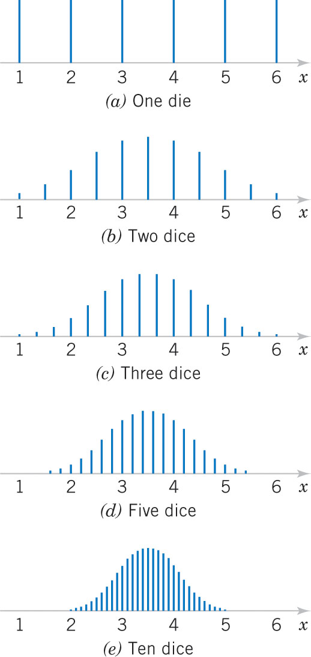
Sampling Distributions of Sample Means
Figure 7-1 Distributions of average scores from throwing dice. Mean = 3.5

Slide 10
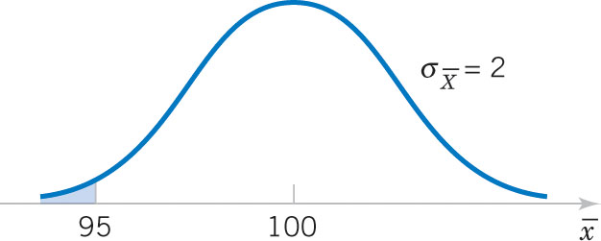
Example 7-1: Resistors
An electronics company manufactures resistors having a mean resistance of 100 ohms and a standard deviation of 10 ohms. The distribution of resistance is normal. What is the probability that a random sample of n = 25 resistors will have an average resistance of less than 95 ohms?
Figure 7-2 Desired probability is shaded
Answer:

Slide 11
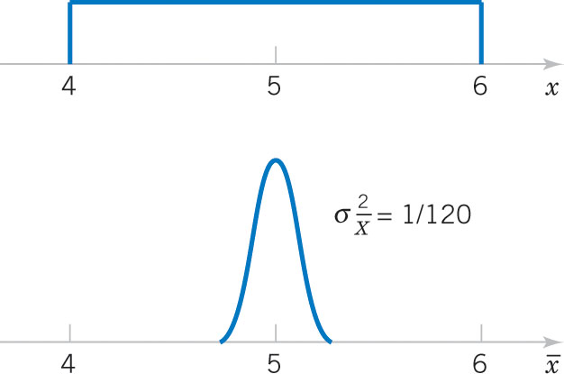
Example 7-2: Central Limit Theorem
Suppose that a random variable X has a continuous uniform distribution:
Find the distribution of the sample mean of a random sample of size n = 40.
Figure 7-3 Distributions of X and X-bar

Slide 12
Two Populations
We have two independent normal populations. What is the distribution of the difference of the sample means?

Slide 13
Sampling Distribution of a Difference in Sample Means
If we have two independent populations with means μ₁ and μ₂, and variances σ₁² and σ₂²,
And if X-bar₁ and X-bar₂ are the sample means of two independent random samples of sizes n₁ and n₂ from these populations:
Then the sampling distribution of:
is approximately standard normal, if the conditions of the central limit theorem apply.
If the two populations are normal, then the sampling distribution is exactly standard normal.

Slide 14
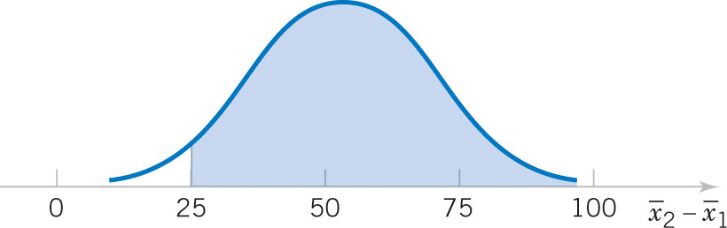
Example 7-3: Aircraft Engine Life
The effective life of a component used in jet-turbine aircraft engines is a normal-distributed random variable with parameters shown (old). The engine manufacturer introduces an improvement into the manufacturing process for this component that changes the parameters as shown (new).
Random samples are selected from the “old” process and “new” process as shown.
What is the probability the difference in the two sample means is at least 25 hours?
Figure 7-4 Sampling distribution of the sample mean difference.

Slide 15
General Concepts of Point Estimation
We want point estimators that are:
Are unbiased.
Have a minimal variance.
We use the standard error of the estimator to calculate its mean square error.

Slide 16
Unbiased Estimators Defined

Slide 17
Example 7-4: Sample Man & Variance Are Unbiased-1
X is a random variable with mean μ and variance σ². Let X₁, X₂,…,X_{n} be a random sample of size n.
Show that the sample mean (X-bar) is an unbiased estimator of μ.

Slide 18
Example 7-4: Sample Man & Variance Are Unbiased-2
Show that the sample variance (S²) is a unbiased estimator of σ².

Slide 19
Other Unbiased Estimators of the Population Mean
All three statistics are unbiased.
Do you see why?
Which is best?
We want the most reliable one.

Slide 20
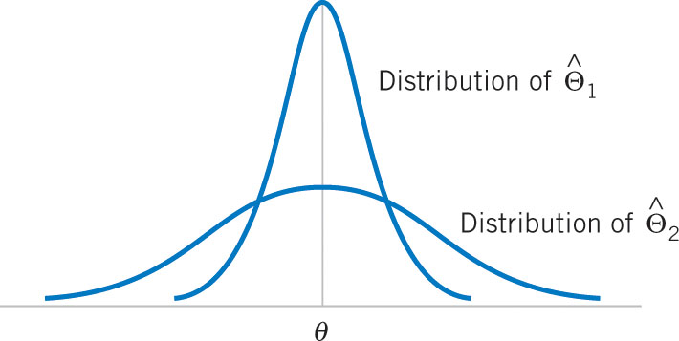
Choosing Among Unbiased Estimators
Figure 7-5 The sampling distributions of two unbiased estimators.

Slide 21
Minimum Variance Unbiased Estimators
If we consider all unbiased estimators of θ, the one with the smallest variance is called the minimum variance unbiased estimator (MVUE).
If X₁, X₂,…, X_{n} is a random sample of size n from a normal distribution with mean μ and variance σ², then the sample X-bar is the MVUE for μ.
The sample mean and a single observation are unbiased estimators of μ. The variance of the:
Sample mean is σ²/n
Single observation is σ²
Since σ²/n ≤ σ², the sample mean is preferred.

Slide 22
Standard Error of an Estimator

Slide 23
Example 7-5: Thermal Conductivity
These observations are 10 measurements of thermal conductivity of Armco iron.
Since σ is not known, we use s to calculate the standard error.
Since the standard error is 0.2% of the mean, the mean estimate is fairly precise. We can be very confident that the true population mean is 41.924 ± 2(0.0898).

Slide 24
Mean Squared Error
Conclusion: The mean squared error (MSE) of the estimator is equal to the variance of the estimator plus the bias squared. It measures both characteristics.

Slide 25
Relative Efficiency
The MSE is an important criterion for comparing two estimators.
If the relative efficiency is less than 1, we conclude that the 1st estimator is superior to the 2nd estimator.

Slide 26
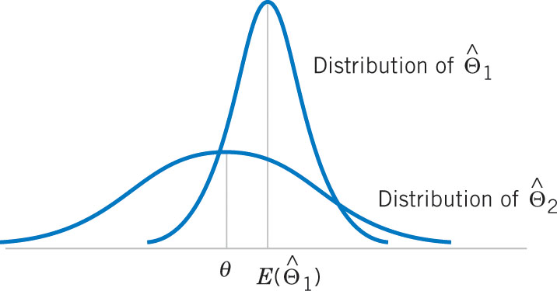
Optimal Estimator
A biased estimator can be preferred to an unbiased estimator if it has a smaller MSE.
Biased estimators are occasionally used in linear regression.
An estimator whose MSE is smaller than that of any other estimator is called an optimal estimator.
Figure 7-6 A biased estimator has a smaller variance than the unbiased estimator.

Slide 27
Methods of Point Estimation
There are three methodologies to create point estimates of a population parameter.
Method of moments
Method of maximum likelihood
Bayesian estimation of parameters
Each approach can be used to create estimators with varying degrees of biasedness and relative MSE efficiencies.

Slide 28
Method of Moments
A “moment” is a kind of an expected value of a random variable.
A population moment relates to the entire population or its representative function.
A sample moment is calculated like its associated population moments.

Slide 29
Moments Defined
Let X₁, X₂,…,X_{n} be a random sample from the probability f(x), where f(x) can be either a:
Discrete probability mass function, or
Continuous probability density function
The k^{th} population moment (or distribution moment) is E(X^{k}), k = 1, 2, ….
The k^{th} sample moment is (1/n)ΣX^{k}, k = 1, 2, ….
If k = 1 (called the first moment), then:
Population moment is μ.
Sample moment is x-bar.
The sample mean is the moment estimator of the population mean.

Slide 30
Moment Estimators

Slide 31
Example 7-6: Exponential Moment Estimator-1
Suppose that X₁, X₂, …, X_{n} is a random sample from an exponential distribution with parameter λ.
There is only one parameter to estimate, so equating population and sample first moments, we have E(X) = X-bar.
E(X) = 1/λ = x-bar
λ = 1/x-bar is the moment estimator.

Slide 32
Example 7-6: Exponential Moment Estimator-2
As an example, the time to failure of an electronic module is exponentially distributed.
Eight units are randomly selected and tested. Their times to failure are shown.
The moment estimate of the λ parameter is 0.04620.

Slide 33
Example 7-7: Normal Moment Estimators
Suppose that X₁, X₂, …, X_{n} is a random sample from a normal distribution with parameter μ and σ². So E(X) = μ and E(X²) = μ² + σ².

Slide 34
Example 7-8: Gamma Moment Estimators-1

Slide 35
Example 7-8: Gamma Moment Estimators-2
Using the exponential example data shown, we can estimate the parameters of the gamma distribution.

Slide 36
Maximum Likelihood Estimators
Suppose that X is a random variable with probability distribution f(x:θ), where θ is a single unknown parameter. Let x₁, x₂, …, x_{n} be the observed values in a random sample of size n. Then the likelihood function of the sample is:
L(θ) = f(x₁: θ) ∙ f(x₂; θ) ∙…∙ f(x_{n}: θ) (7-9)
Note that the likelihood function is now a function of only the unknown parameter θ. The maximum likelihood estimator (MLE) of θ is the value of θ that maximizes the likelihood function L(θ).
If X is a discrete random variable, then L(θ) is the probability of obtaining those sample values. The MLE is the θ that maximizes that probability.

Slide 37
Example 7-9: Bernoulli MLE
Let X be a Bernoulli random variable. The probability mass function is f(x;p) = p^{x}(1-p)^{1-x}, x = 0, 1 where P is the parameter to be estimated. The likelihood function of a random sample of size n is:

Slide 38
Example 7-10: Normal MLE for μ
Let X be a normal random variable with unknown mean μ and known variance σ². The likelihood function of a random sample of size n is:

Slide 39
Example 7-11: Exponential MLE
Let X be a exponential random variable with parameter λ. The likelihood function of a random sample of size n is:

Slide 40
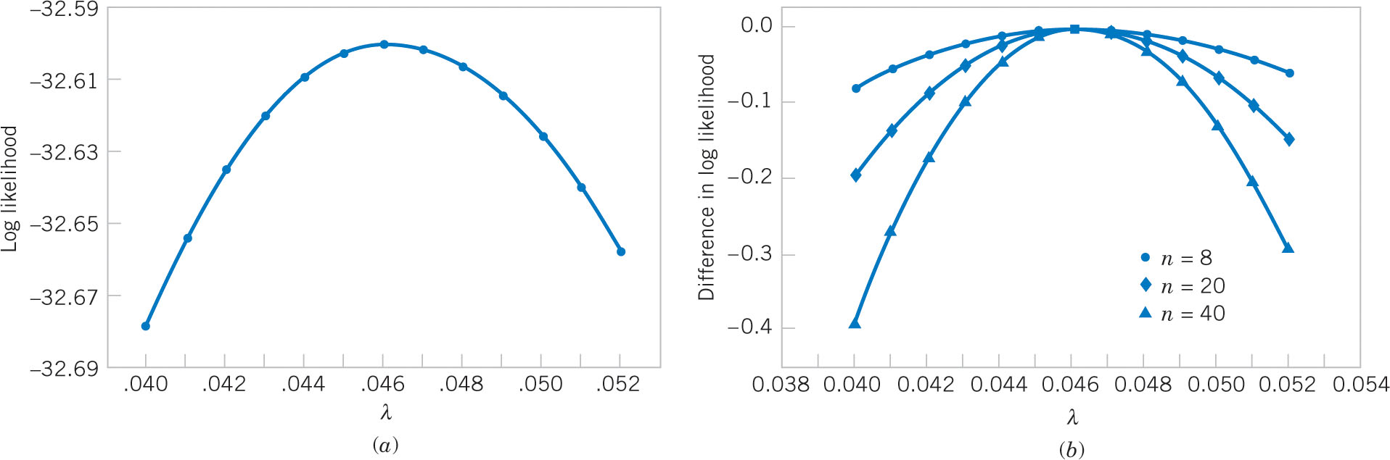
Why Does MLE Work?
From Examples 7-6 & 11 using the 8 data observations, the plot of the ln L(λ) function maximizes at λ = 0.0462. The curve is flat near max indicating estimator not precise.
As the sample size increases, while maintaining the same x-bar, the curve maximums are the same, but sharper and more precise.
Large samples are better☺
Figure 7-7 Log likelihood for exponential distribution. (a) n = 8, (b) n = 8, 20, 40.

Slide 41
Example 7-12: Normal MLEs for μ & σ²
Let X be a normal random variable with both unknown mean μ and variance σ². The likelihood function of a random sample of size n is:

Slide 42
Properties of an MLE
Notes:
Mathematical statisticians will often prefer MLEs because of these properties. Properties (1) and (2) state that MLEs are MVUEs.
To use MLEs, the distribution of the population must be known or assumed.

Slide 43
Importance of Large Sample Sizes
Consider the MLE for σ² shown in Example 7-12:
Since the bias is negative, the MLE underestimates the true variance σ².
The MLE is an asymptotically (large sample) unbiased estimator. The bias approaches zero as n increases.

Slide 44
Invariance Property
This property is illustrated in Example 7-13.

Slide 45
Example 7-13: Invariance
For the normal distribution, the MLEs were:

Slide 46
Complications of the MLE Method
The method of maximum likelihood is an excellent technique, however there are two complications:
It may not be easy to maximize the likelihood function because the derivative function set to zero may be difficult to solve algebraically.
The likelihood function may be impossible to solve, so numerical methods must be used.
The following two examples illustrate.

Slide 47
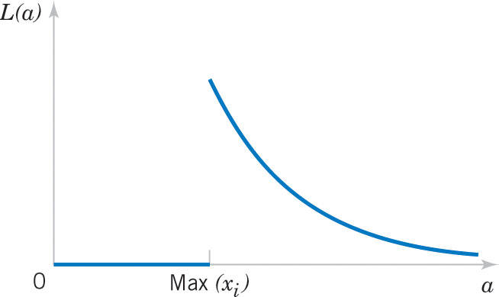
Example 7-14: Uniform Distribution MLE
Let X be uniformly distributed on the interval 0 to a.
Figure 7-8 The likelihood function for this uniform distribution
Calculus methods don’t work here because L(a) is maximized at the discontinuity.
Clearly, a cannot be smaller than max(x_{i}), thus the MLE is max(x_{i}).

Slide 48
Example 7-15: Gamma Distribution MLE-1
Let X₁, X₂, …, X_{n} be a random sample from a gamma distribution. The log of the likelihood function is:

Slide 49
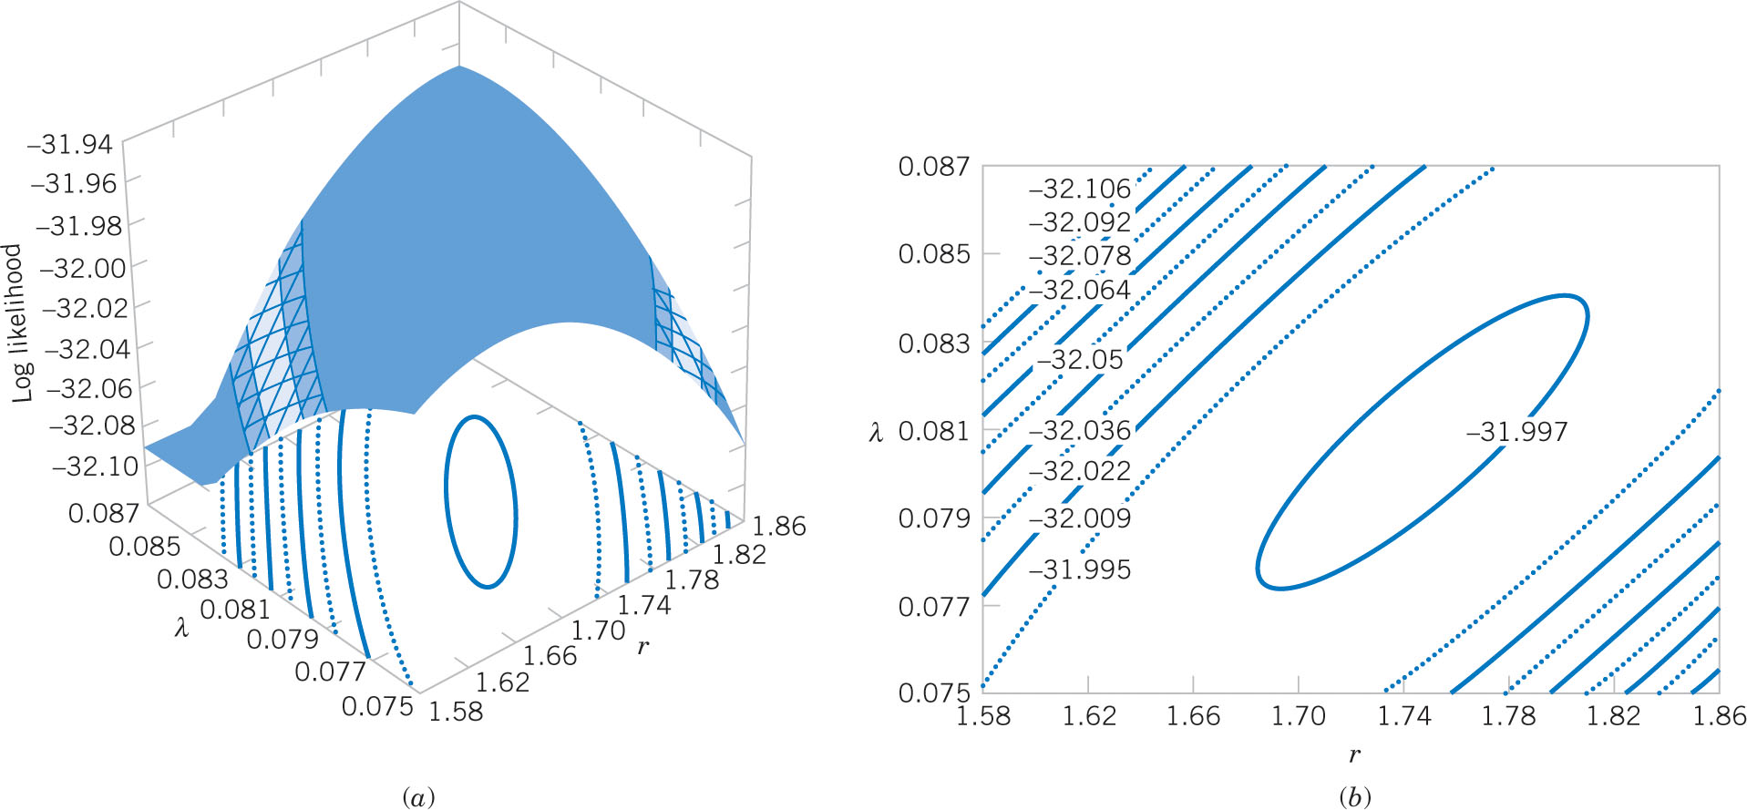
Example 7-15: Gamma Distribution MLE-2
Figure 7-9 Log likelihood for the gamma distribution using the failure time data (n=8). (a) is the log likelihood surface. (b) is the contour plot. The log likelihood function is maximized at r = 1.75, λ = 0.08 using numerical methods. Note the imprecision of the MLEs inferred by the flat top of the function.

Slide 50
Bayesian Estimation of Parameters-1
The moment and likelihood methods interpret probabilities as relative frequencies and are called objective frequencies.
The Bayesian method combines sample information with prior information.
The random variable X has a probability distribution of parameter θ called f(x|θ). θ could be determined by classical methods.
Additional information about θ can be expressed as f(θ), the prior distribution, with mean μ₀ and variance σ₀², with θ as the random variable. Probabilities associated with f(θ) are subjective probabilities.
The joint distribution is f(x₁, x₂, …, x_{n}, θ)
The posterior distribution is f(θ|x₁, x₂, …, x_{n}) is our degree of belief regarding θ after gathering data

Slide 51
Bayesian Estimation of Parameters-2
Now putting these together, the joint is:
f(x₁, x₂, …, x_{n}, θ) = f(x₁, x₂, …, x_{n} |θ) ∙ f(θ)
The marginal is:
The desired posterior distribution is:
And the Bayesian estimator of θ is the expected value of the posterior distribution

Slide 52
Example 7-16: Bayes Estimator for a Normal Mean-1
Let X₁, X₂, …, X_{n} be a random sample from a normal distribution unknown mean μ and known variance σ². Assume that the prior distribution for μ is:
The joint distribution of the sample is:

Slide 53
Example 7-16: Bayes Estimator for a Normal Mean-2
Now the joint distribution of the sample and μ is:

Slide 54
Example 7-16: Bayes Estimator for a Normal Mean-3
After all that algebra, the bottom line is:
Observations:
Estimator is a weighted average of μ₀ and x-bar.
x-bar is the MLE for μ.
The importance of μ₀ decreases as n increases.

Slide 55
Example 7-16: Bayes Estimator for a Normal Mean-4
To illustrate:
The prior parameters: μ₀ = 0, σ₀²= 1
Sample: n = 10, x-bar = 0.75, σ² = 4

Slide 56
Important Terms & Concepts of Chapter 7
Bayes estimator
Bias in parameter estimation
Central limit theorem
Estimator vs. estimate
Likelihood function
Maximum likelihood estimator
Mean square error of an estimator
Minimum variance unbiased estimator
Moment estimator
Normal distribution as the sampling distribution of the:
sample mean
difference in two sample means
Parameter estimation
Point estimator
Population or distribution moments
Posterior distribution
Prior distribution
Sample moments
Sampling distribution
An estimator has a:
Standard error
Estimated standard error
Statistic
Statistical inference
Unbiased estimator

